Slide 1
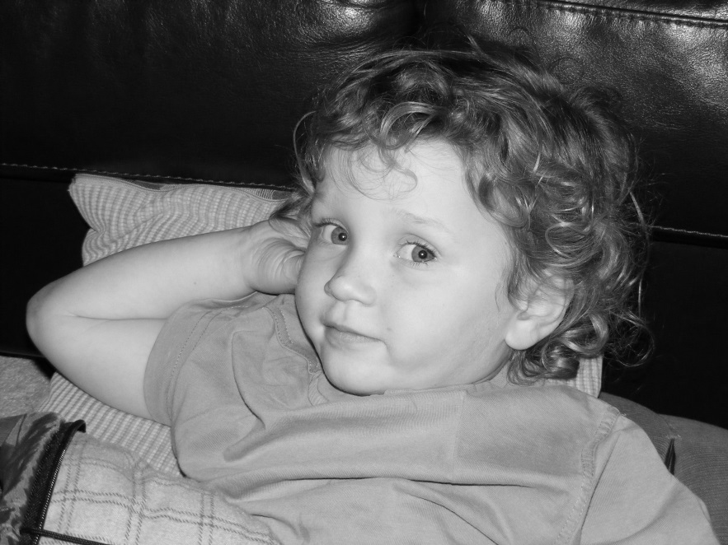
Attachment

Slide 2
So far we have looked at:
Learning theory. Pavlov, Skinner.
Evolutionary theory. Lorenz, Bowlby. Harlow
Secure and Insecure attachment. Mary Ainsworth.

Slide 3
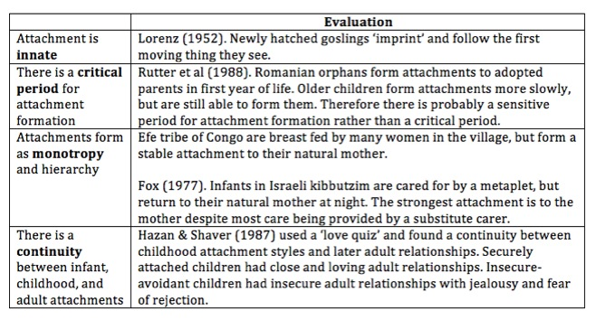
What causes the difference?

Slide 4
Caregiver sensitivity hypothesis
Ainsworth argues that the way the mother or caregiver behaves towards an infant directly causes the infant’s attachment type.
Securely attached infants have mothers who are sensitive to their needs.
insecure-avoidant infants have mothers who ignore them when they need comfort or are distressed.
insecure-resistant infants have mothers who behave ambivalently or inconsistently towards them and put their own needs first.

Slide 5
Temperament hypothesis
(Kagan, 1982) argues that some infants are born with an innate personality that makes them more friendly, and so it is easier for the mother or caregiver to be caring and nurturing, whereas other infants have difficult personalities that make it less likely the mother will want to comfort them. Belsky & Rovine (1987) found that babies who were born with signs of behavioural difficulties were less likely to become securely attached to their mothers than babies who seemed ‘normal’ when born.

Slide 6
Meta Analysis
A procedure in which the researcher draw together and analyse the results of many different studies that have used similar procedure. A meta-analysis uses only quantitative data.

Slide 7
De Wolff and Van Ijzendoorn
Looked at the relationship between parent sensitivity and secure attachment using meta analysis. 66 studies (4000 families) weak positive. I.e. In general more sensitive caregivers have more securely attached babies. Supports the idea that greater sensitivity of the care giver the greater the attachment.

Slide 8
Limitations of Descriptions!
Disorganised Attachment (Main and Soloman). Inconsistent behaviour

Slide 9
Evaluating the Strange Situation
The strange situation is a valuable research tool that allows a fairly easy judgement to be made about the attachment type of infants, both in clinical and research settings.
The sample used by Ainsworth & Bell (1970) consisted of 106 middle-class American infants. It therefore lacks population validity as it is biased towards middle-class Americans, ignores poorer Americans and non-American cultures, and so the findings cannot be generalised to all human children from all socio-economic and cultural backgrounds.

Slide 10
A Level exam tips
Answering exam questions (PSYA1 AQA A specification)
How can the strange situation be used to measure attachment type? (4 marks)
4 AO3 marks: This question is asking you to apply your knowledge of the strange situation to a novel situation. A good answer will state that the strange situation is a controlled observation, and will describe the main procedure. There is no need to evaluate the strange situation.

Slide 11
Billy’s mother often ignores him when he is crying, and only plays with him when she wants to, even if it means waking him up. What attachment type is Billy most likely to have? (2 marks)
2 AO3 marks: This question is asking you to apply your knowledge of attachment types to a novel situation. Billy’s mother behaves ambivalently towards him, does not care for his needs, and is only interested in her own needs. Billy is therefore likely to be insecure-resistant or Type C.

